Slide 1
Know your Weather!!!
Presenters:
Vaishali Tanwar
Siddharth Dave
Charlene Guo
Chris Choi

Slide 2
DATA COLLECTION AND STORAGE

Slide 3
DATA SOURCE
Data collected using Open Weather API
Current weather API : api.openweathermap.org/data/2.5/weather?q={city name}&appid={your api key}
Notes:
Data pulled everyday using the API endpoint for about 900+ different cities(from 3rd june till 13th june) to create a historical database of weather data of the different cities.

Slide 4
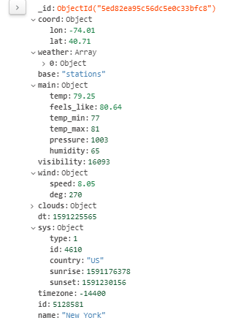

Slide 5
DATA STORAGE
Response from the API stored in MongoDB
MongoDB Atlas, a cloud based database used to store the database created using Weather API which is hosted on AWS(Amazon Web Services) cloud

Slide 6
ACCESSING DATA

Slide 7
ACCESSING DATA VIA FLASK
Three routes created to access the data:
@app.route(“/”)- to render the html page containing the visualizations
@app.route(“api/v1.0/weather_data”)- to access the entire data on the database
@app.route(“api/v1.0/weather_data/<city_name>”)- to access the data corresponding to specific cities
Notes:
The html page contains basic layout of the weather dashboard,various links to the style sheets applied to the page and also the style sheets for bootstrap, leaflet along with the paths to the javascript code which has been used to create the various visualisations.

Slide 8
VISUALIZATIONS

Slide 9
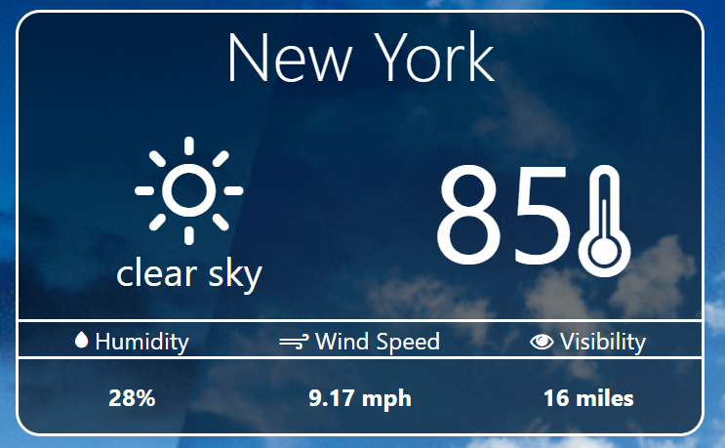
WEATHER CARD

Slide 10
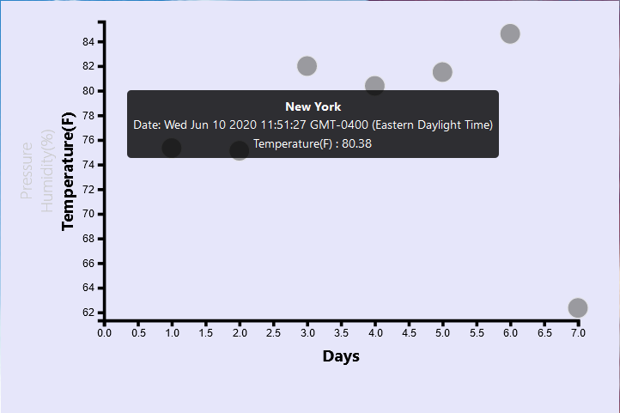
SCATTER PLOT

Slide 11
Javascript library D3.js has been used to create the plot, using Scalable Vector Graphics(SVG)
The plot shows the temperature, humidity and pressure conditions for the past 7 days of a particular city selected by the user.
Toggle options have been provided on the y axis to switch between the available weather conditions
Tooltip has also been added displaying the name of city, corresponding weather conditions and the timestamp.

Slide 12
Data Extraction Method
Locate proper rows of data by picking out the input city.
Cast json string values into numeric values.
Pick out the last 7 entries of the input city.

Slide 13
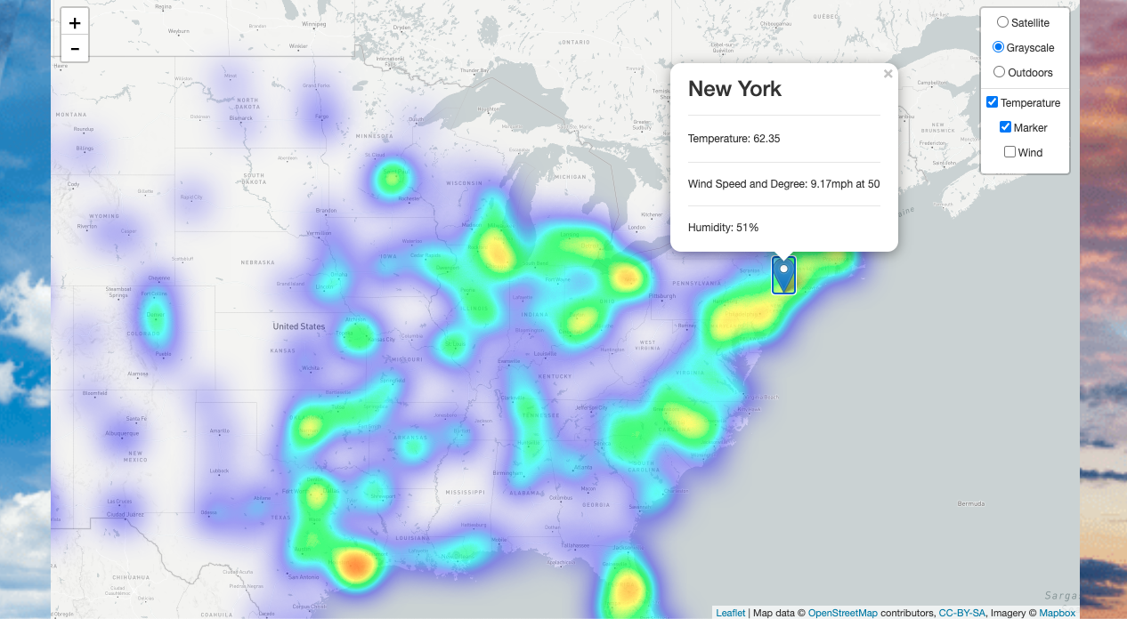
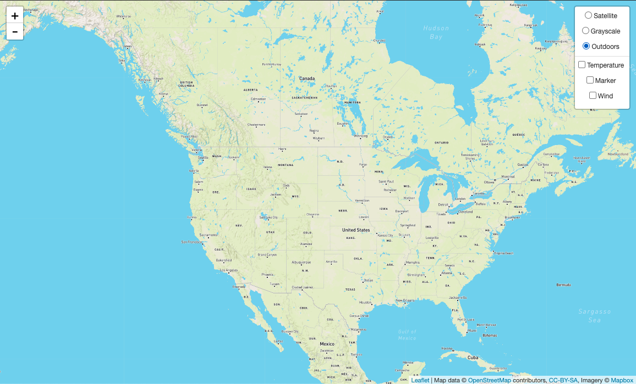
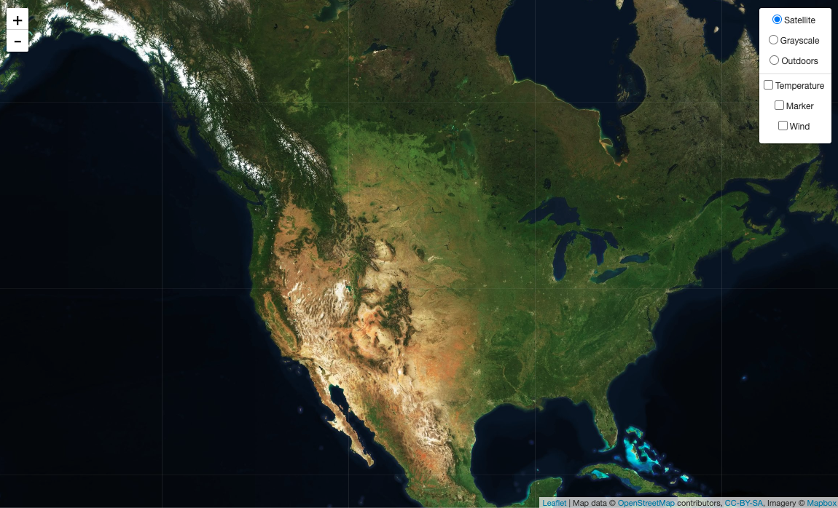
LEAFLET MAP

Slide 14
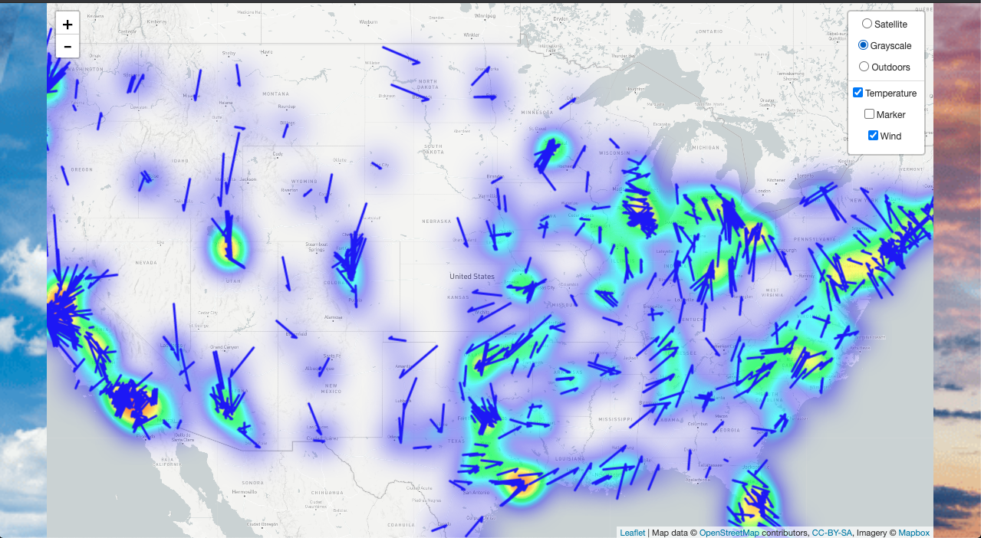
LEAFLET MAP

Slide 15
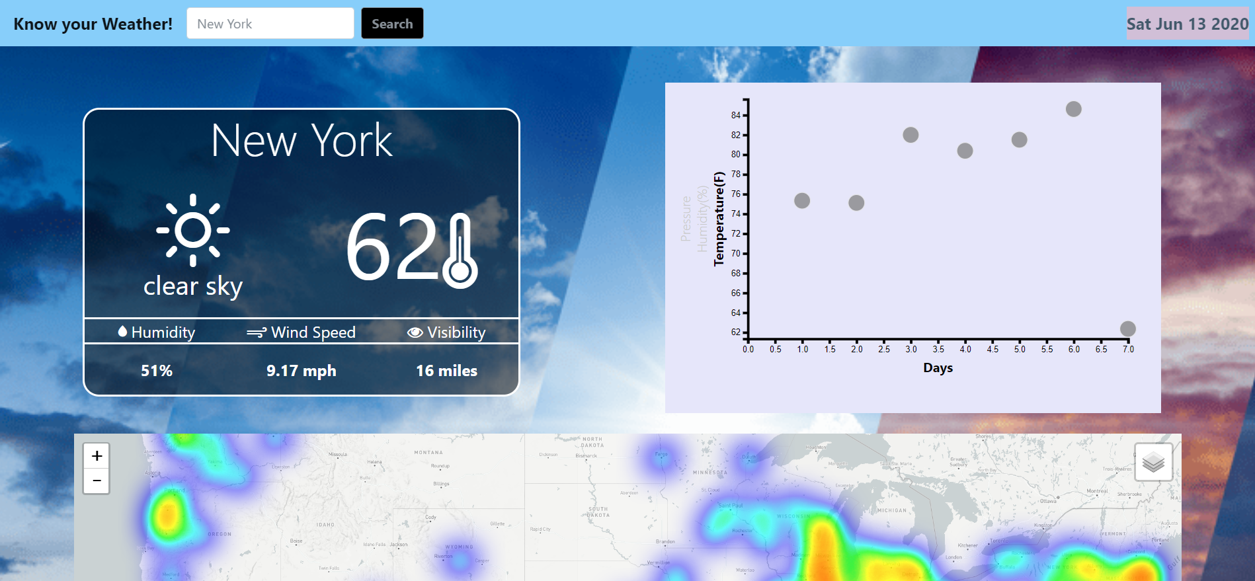
DEMO - http://127.0.0.1:5000/
Look for an obvious but not so obvious easter egg on webpage

Slide 16
Thank you

